Slide 1
Comparative Effectiveness of Shelter in Place
DATA INCUBATOR 2020
Zeinab Gaeini

Slide 2
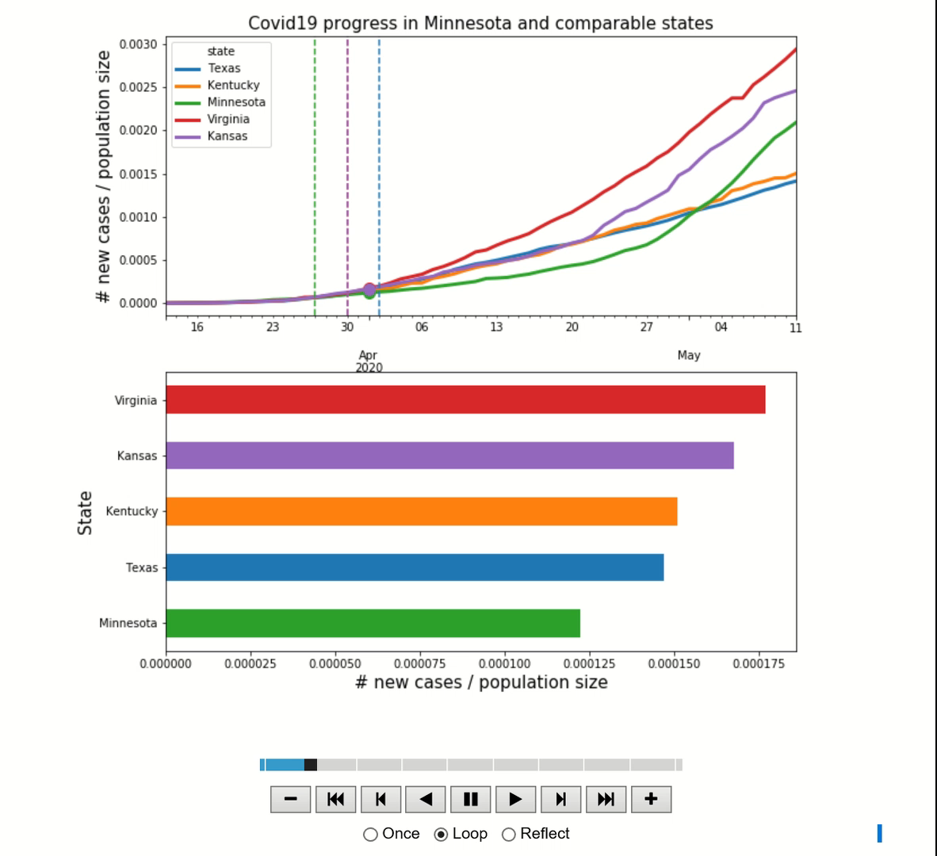
Covid 19 progress in Minnesota and comparable states

Slide 3
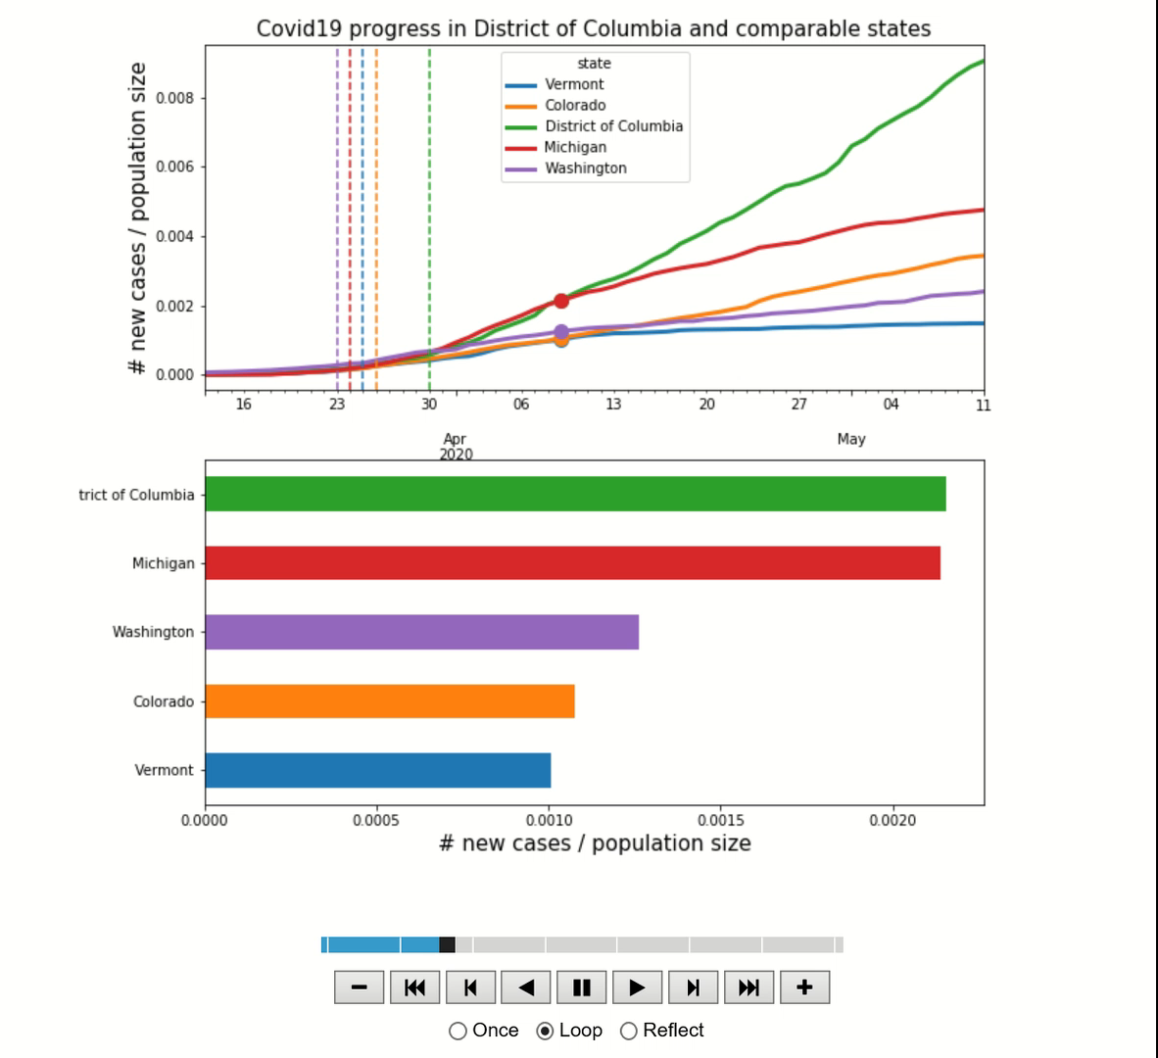
Covid 19 progress in District of Columbia and comparable states

Slide 4
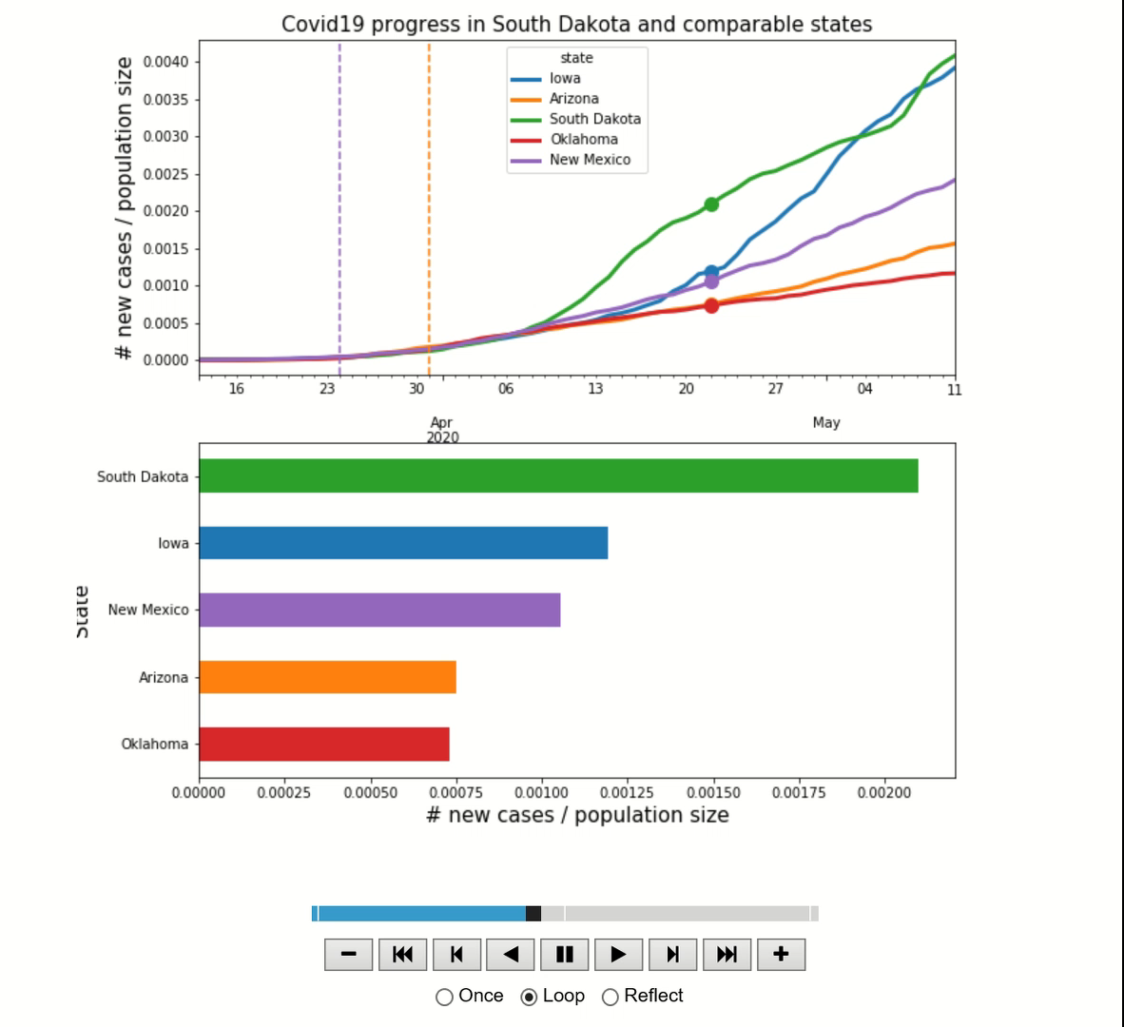
Covid 19 progress in South Dakota and comparable states

